Slide 1


Heart Disease Prediction
Presented By - Pranjal Rodge

Slide 2

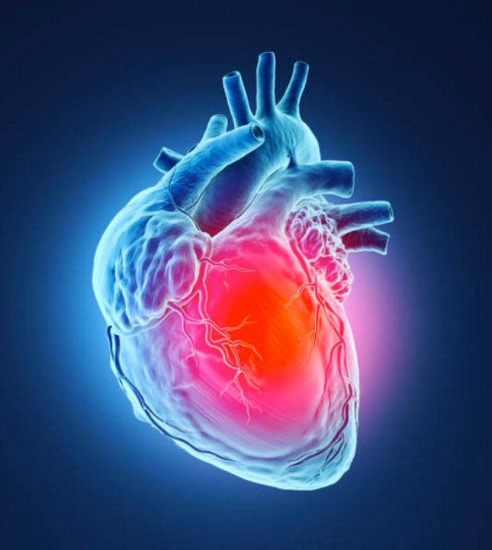


Contents
01
02
Introduction
Data set
03
Architecture of Heart Disease Prediction
04
Machine Learning
05
06
Algorithms used in Project
Visualization
07
Conclusion

Slide 3
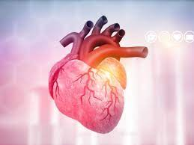

1.Intoduction
Cardiovascular diseases (CVDs) are the number 1 cause of death globally, taking an estimated 17.9 million lives each year, which accounts for 31% of all deaths worldwide. Four out of 5CVD deaths are due to heart attacks and strokes, and one-third of these deaths occur prematurely in people under 70 years of age. Heart failure is a common event caused by CVDs and this dataset contains 11 features that can be used to predict a possible heart disease.
People with cardiovascular disease or who are at high cardiovascular risk (due to the presence of one or more risk factors such as hypertension, diabetes, hyperlipidaemia or already established disease) need early detection and management wherein a machine learning model can be of great help.

Slide 4

-2. Data Set -
This data set dates from 1988 and consists of four databases: Cleveland, Hungary, Switzerland, and Long Beach V.
It contains 76 attributes, including the predicted attribute, but all published experiments refer to using a subset of 14 of them.
The "target" field refers to the presence of heart disease in the patient. It is integer valued 0 = no disease and 1 = disease.

Slide 5
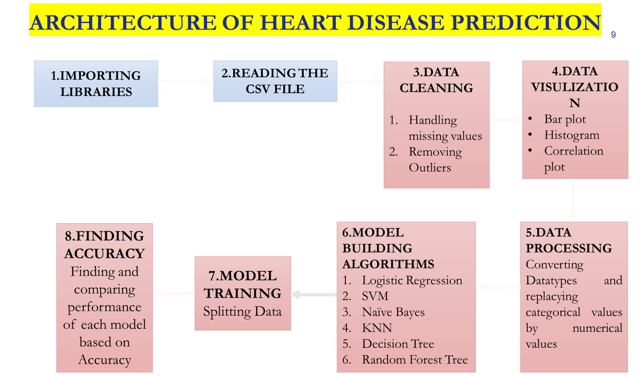
3.

Slide 6

4.Machine Learning
What is Machine Leaining
•Machine Learning (ML) is a type of artificial intelligence (AL) focused on building computer systems that learn from data.
•The broad range of techniques ML encompasses enables software applications to improve their performance over time.
•Machine learning algorithms are able to detect patterns in data and learn from them, in order to make their own predictions.

Slide 7
1. Supervised Machine Leaning : This type of ML involves supervision, where machines are trained on labelled datasets and enabled to predict outputs based on the provided training.
It is classified into two categories:
a. Classification
b. Regression
2. Unsupervised Machine Learning : Here, the machine is trained using an unlabelled dataset and is enabled to predict the output without any supervision.
It is classified into two types:
a. Clustering
b. Association
3. Reinforcement Machine Learning : Here, the machine learns to preform an action from experience. It is trained using a reward – based system. If the machine performs the action correctly, it gets a reward and vice versa.
Types of Machine Learning

Slide 8
5. Algorithms used in Project
Logistic Regression Algorithm :
Logistic regression is a statistical analysis method to predict a binary outcome, such as yes or no, based on prior observations of a data set.
2. Support Vector Machine(SVM):
It is a type of supervised machine learning algorithm. Here, Machine Learning models learn from the past input data and predict the output.
3. Naive Bayes Algorithm:
The Naïve Bayes classifier is used for classification tasks, like text classification. It is also part of a family of generative learning algorithms, meaning that it seeks to model the distribution of inputs of a given class or category.

Slide 9
5. Algorithms used in Project
4. K-Nearest Neighbor(KNN) :
The k-nearest neighbors algorithm, also known as KNN or k-NN, is a non-parametric, supervised learning classifier, which uses proximity to make classifications or predictions about the grouping of an individual data point.
5. Decision Tree:
1.It is a tree-structured classifier, where internal nodes represent the features of a dataset, branches represent the decision rules and each leaf node represents the outcome.
6. Random Forest:
1.The random-forest classification algorithm is a machine learning technique that employs learning to combine two or more machine learning models to produce a new single model. It works by training the dataset with many decision trees and then presenting the categorization modes of the various trees.

Slide 10
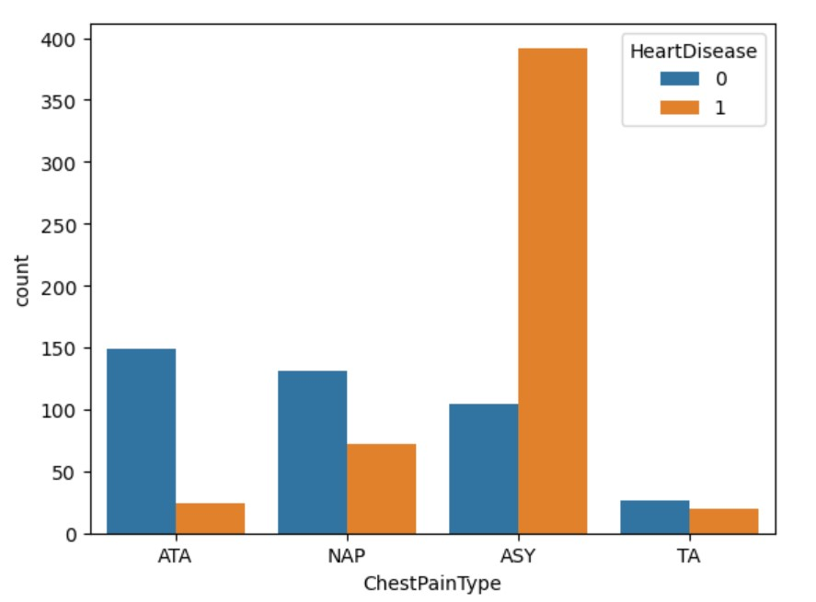
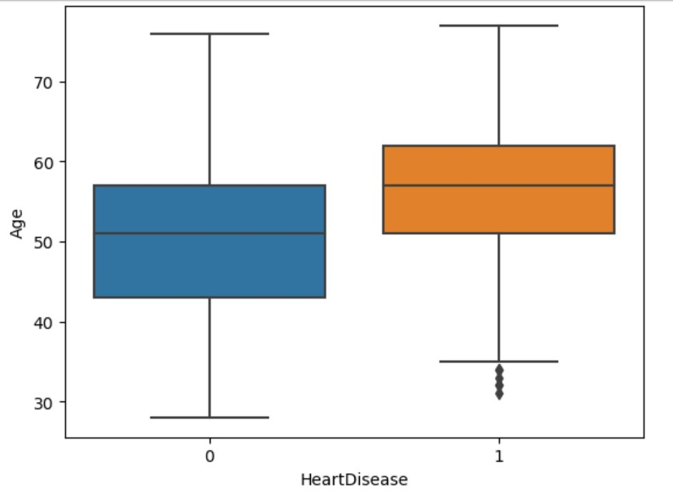
6.Visualization

Slide 11
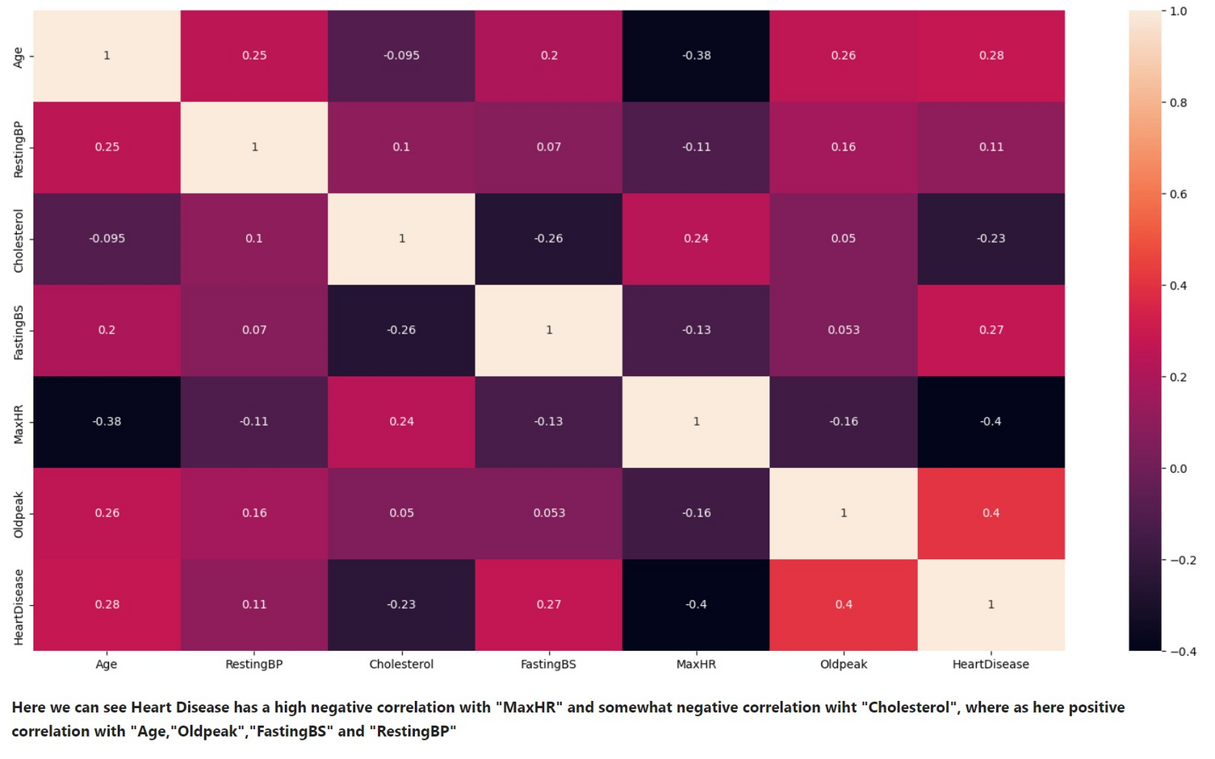
6.Visualization

Slide 12
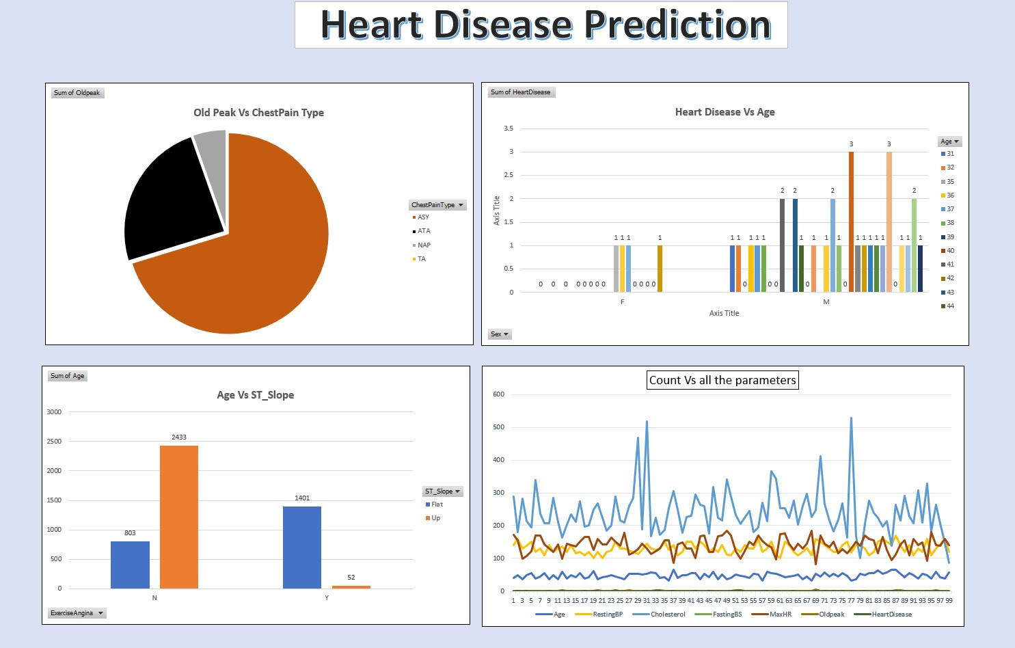
Dashboard

Slide 13
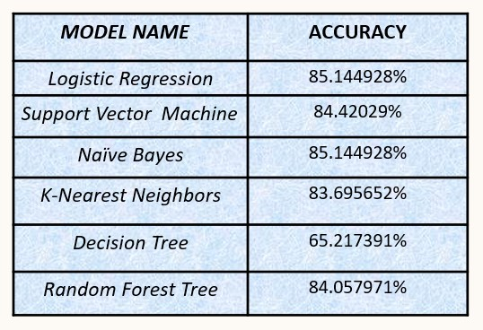
7. Conclusion
Accuracy of the model achieved for Heart Disease dataset is 85.144925%. High accuracy is achieved using Logistic Regression model as well as Naive Bayes Model then the model with all variables while predicting using test dataset.

Slide 14
Thank You

